Slide 1



HOUSING: PRICE PREDICTION

Slide 2
SUBMITTED BY Steffin Varghese

Slide 3
INTRODUCTION
Business Problem Framing
Houses are one of the necessary needs of each and every person around the globe and therefore housing and real estate market is one of the markets which is one of the major contributors in the world’s economy. It is a very large market and there are various companies working in the domain. Our problem is related to one such housing company. A US-based housing company named Surprise Housing has decided to enter the Australian market. The company uses data analytics to purchase houses at a price below their actual values and flip them at a higher price. The company is looking at prospective properties to buy houses to enter the market.

Slide 4
Understanding the Problem
Housing and Real Estate is a very large market and there are various companies working n the domain. Data science comes as a very important tool to solve problems in the domain to help the companies increase their overall revenue, profits, improving their marketing strategies and focusing on changing trends in house sales and purchases. Predictive modelling, Market mix modelling, recommendation systems are some of the machine learning techniques used for achieving the business goals for housing companies. For the same purpose, Surprise Housing has collected a data set from the sale of houses in Australia. The company requirement is to build a model using Machine Learning in order to predict the actual value of the prospective properties and decide whether to invest in them or not. With this Machine Learning model, the company should be able to derive the insights on:
Which variables are important to predict the price of variable?
How do these variables describe the price of the house?
The aim is to model the price of houses with the available independent variables. This model will then be used by the management to understand how exactly the prices vary with the variables. They can accordingly manipulate the strategy of the firm and concentrate on areas that will yield high returns. Further, the model will be a good way for the management to understand the pricing dynamics of a new market.

Slide 5
Steps in Exploratory Data Analysis
Loading the Dataset
Handling the Null Values
Visualization
Applying the PCA Techniques
Data Cleaning
Encoding the categorical variables

Slide 6
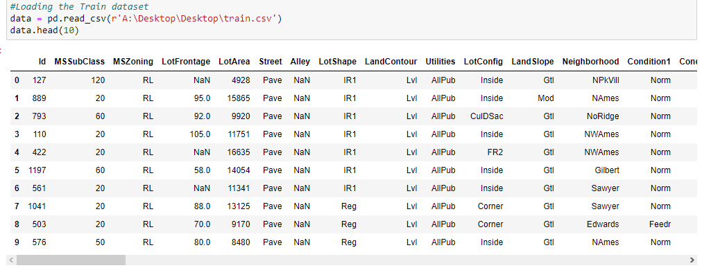
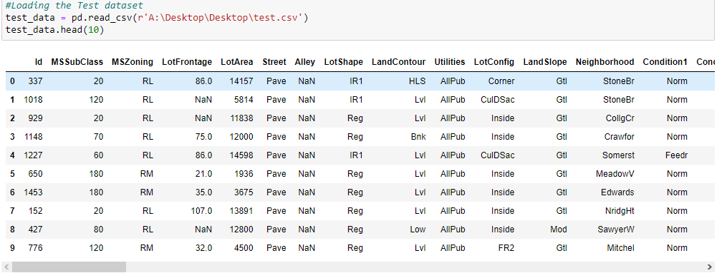
Data Sources and their formats
dfdf
• Data contains 1460 entries each having 81 variables
• We have string, float and integer type of data in the train and test dataset.
• We have 1168 non-null values in all the variables in train data except the columns ['Alley', 'LotFrontage', 'MasVnrType', 'MasVnrArea', 'BsmtQual', 'BsmtCond', 'BsmtExposure', 'BsmtFinType1', 'BsmtFinType2', 'FireplaceQu', 'GarageType', 'GarageYrBlt', 'GarageFinish', 'GarageQual', 'GarageCond', 'PoolQC', 'Fence', 'MiscFeature’].
• We have 292 non-null values in all the variables in test data except the columns ['Alley', 'LotFrontage', 'MasVnrType', 'MasVnrArea', 'BsmtQual', 'BsmtCond', 'BsmtExposure', 'BsmtFinType1', 'BsmtFinType2', 'Electrical', 'FireplaceQu', 'GarageType', 'GarageYrBlt', 'GarageFinish', 'GarageQual', 'GarageCond', 'PoolQC', 'Fence', 'MiscFeature'].

Slide 7
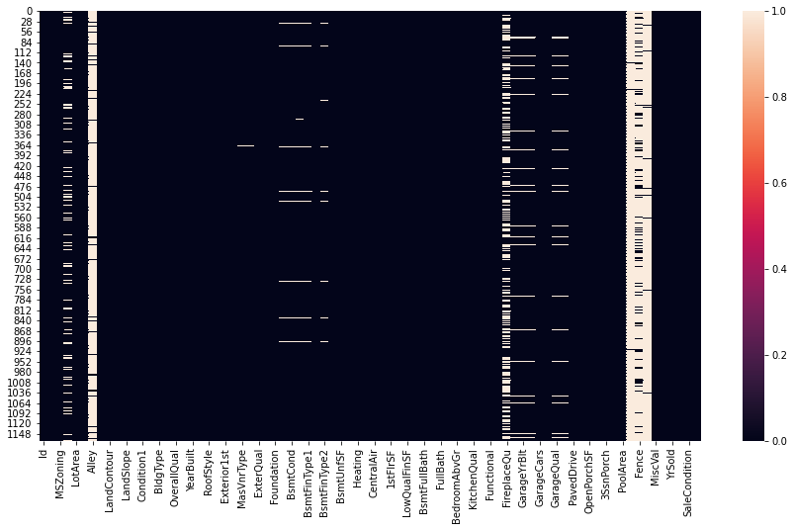
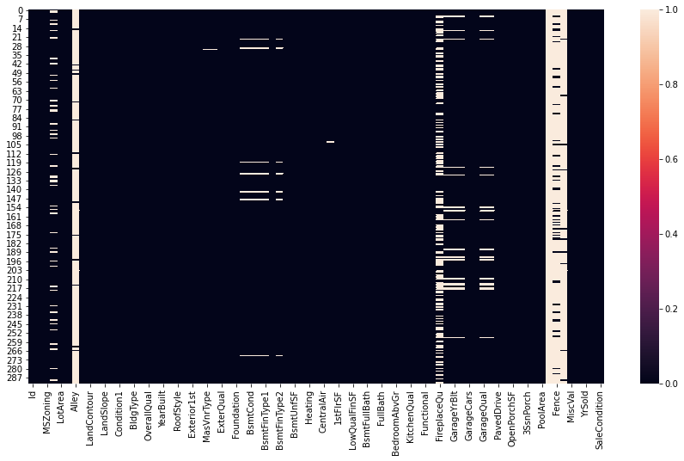
Data Preprocessing
Checking and removing missing Values
Missing data in train dataset
Missing data in test dataset

Slide 8
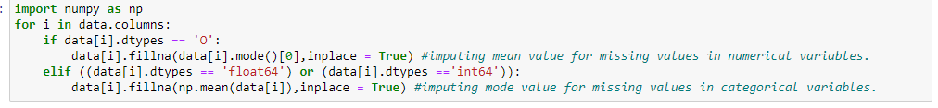
Since the columns ['Alley', 'PoolQC', 'MiscFeature'] are having more than 90% missing values, we dropped these columns from our train and test data as imputing a different value for the missing values in these columns will become biased in model prediction.
We imputed the mean value for missing values in numerical columns and mode value of column for missing values in categorical columns in train dataset.

Slide 9
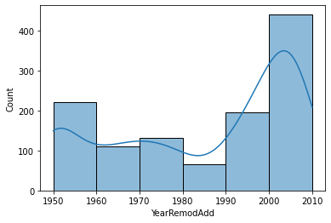
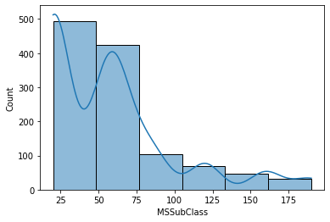
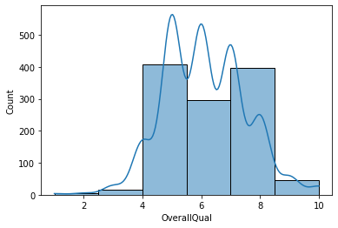
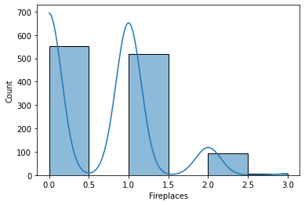
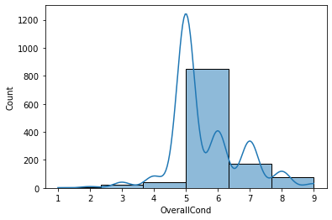
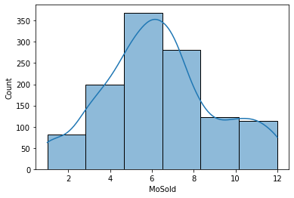
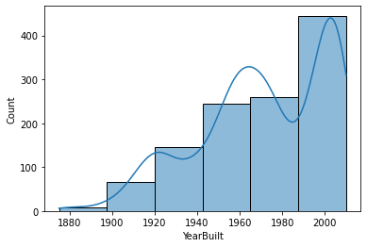
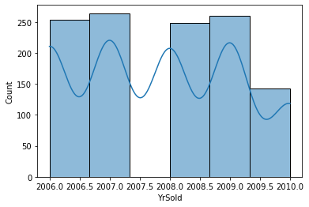
Data Visualization
Univariate Analysis- Numerical Variables
Observations:
Most of the house properties are 1 story or 1 1/2 story houses.
Most of the house properties have a rating of 4-8 out of 10 for overall quality which is a good sign for a prospect house.
Most of the house properties have a rating of 5-6 for overall condition of the house. This seems a good fit for a potential house property.
Most of the houses were built between the year 1987-2010 which seems good. Because most of the houses are not too old.
Most of the houses have been remodeled between the year 2000-2010. That means most of the house properties are not too old and can be good for living for furthermore years.
Most of the houses are having zero or 1 fireplace facility.
Most of the house properties are sold on from May to August
Most of the houses were sold between 2006-2007 and between 2008-2009.

Slide 10
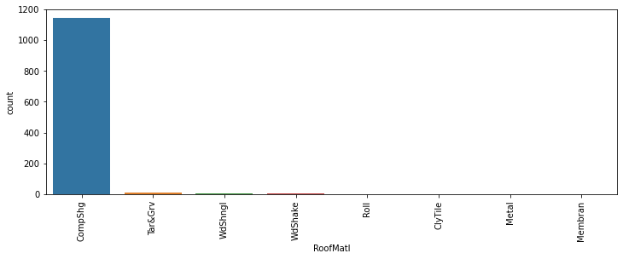
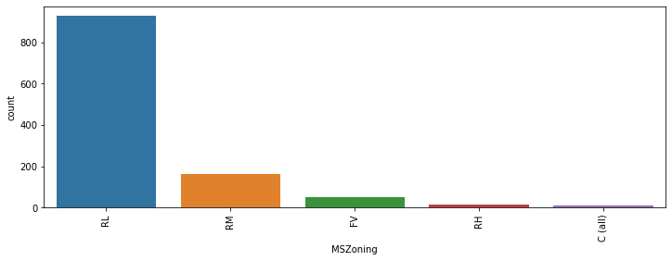
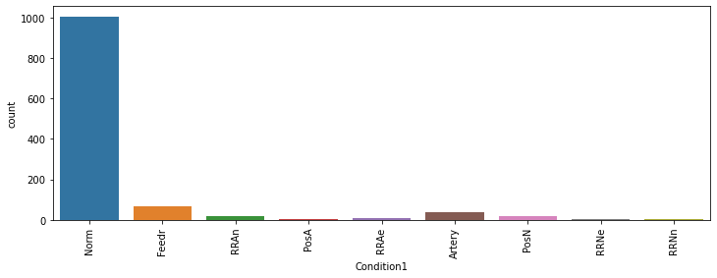
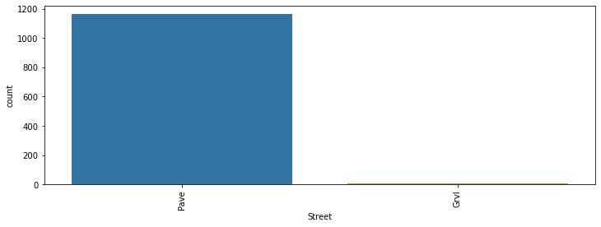
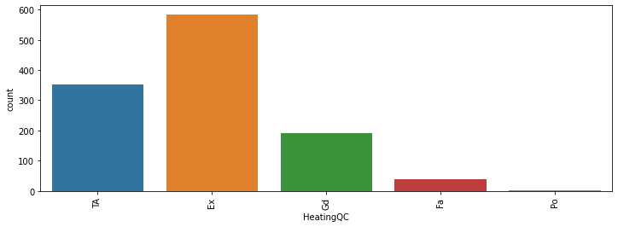
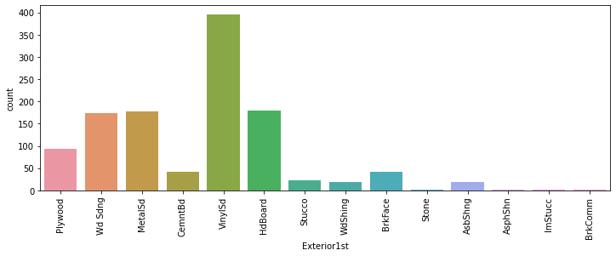
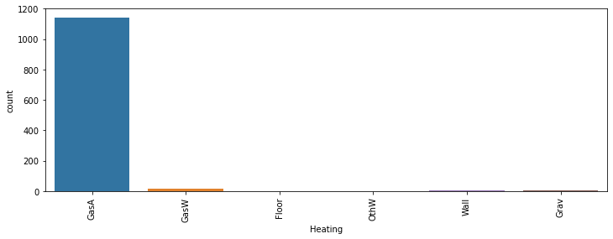
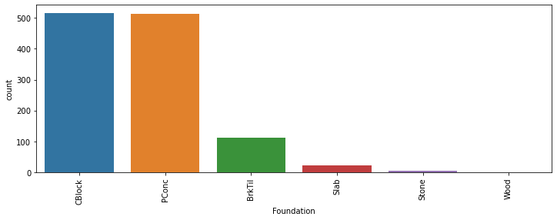
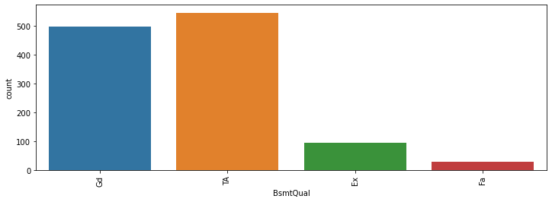
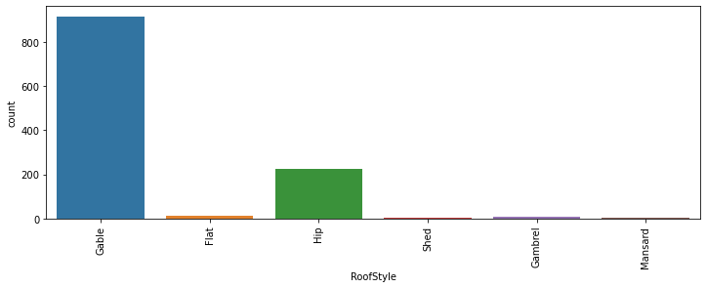
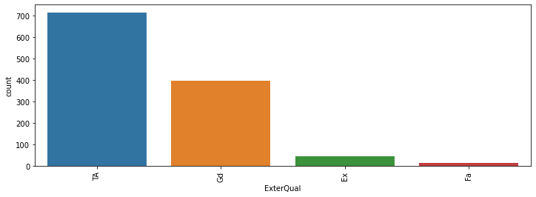
Categorical Variables
Observations:
We can see that most of the properties are in low density residential areas. That means, most of the properties are having high prospect. Because since the area is low densed and residential area, most of the people will be attracted to the area. So, there will be demand for these properties.
Most of the houses have paved road access to the property.
Most of the house properties are not close to any conditions like railroad, arterial street or feeder street etc. Most of the properties are residing in the normal areas.
Most of the properties are 1 story building which is suitable for 1 family.
Most of the house properties are having gable roof style.
Most of the houses were having roof tops made of standard(composite) shingle.
From the above observations, most of the properties are having Vinyl Siding for exterior covering of the house.
Most of the houses have been rated as avearge or typical in quality of exterior material.

Slide 11
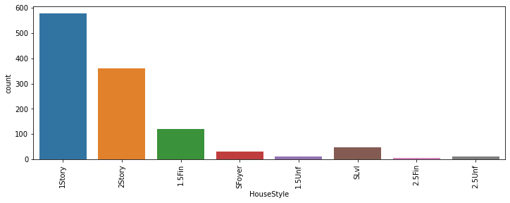
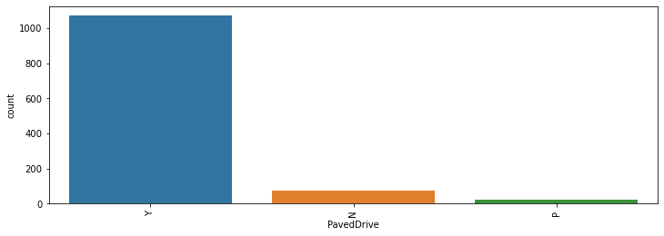
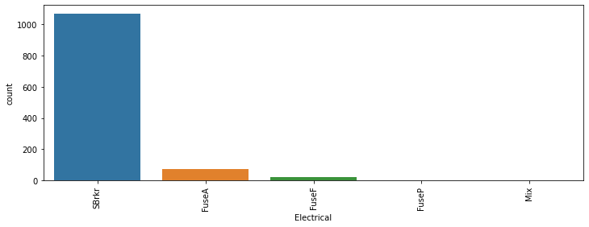
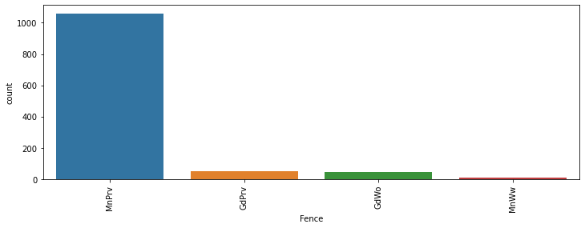
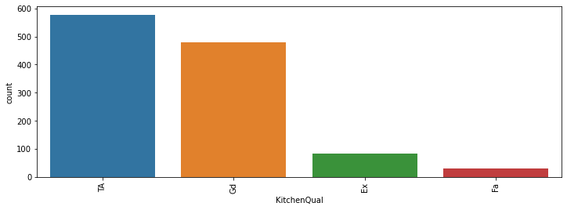
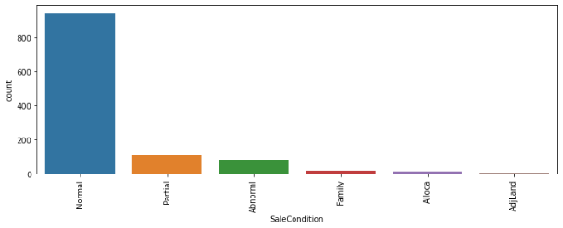
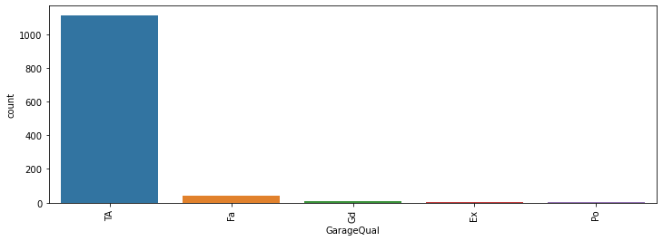
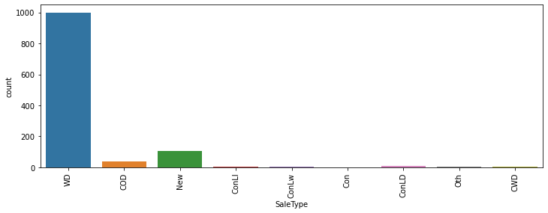

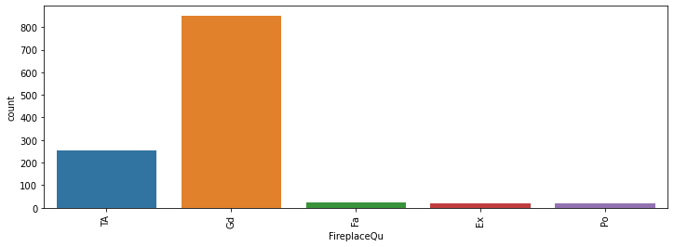
Most of the houses were having Cinder Block or Poured Concrete as material for foundation.
Most of the houses are having 80 to 99 inches basement height. Which are good and typical
Most of the houses are having gas forced warm air furnace for heating.
Most of the houses are having excellent or typical heating quality and condition.
Most of the houses are having Standard Circuit Breaker and Romex electrical system.
Most of the houses are having good and typical or average quality rating for kitchen.
Most of the houses are having Good - Masonry Fireplace in main level for the fireplace quality.
Most of the houses are having typical or average rating for garage available in the house property.
Most of the houses are having typical or average rating for the condition of the garage available in the house property.
Most of the house properties are having paved house driveway.
Most of the hosues are getting minimum privacy from the quality of the fence on the property.
Most of the house properties are sold on warranty deed(Conventional)
Most of the house properties were normally sold.

Slide 12
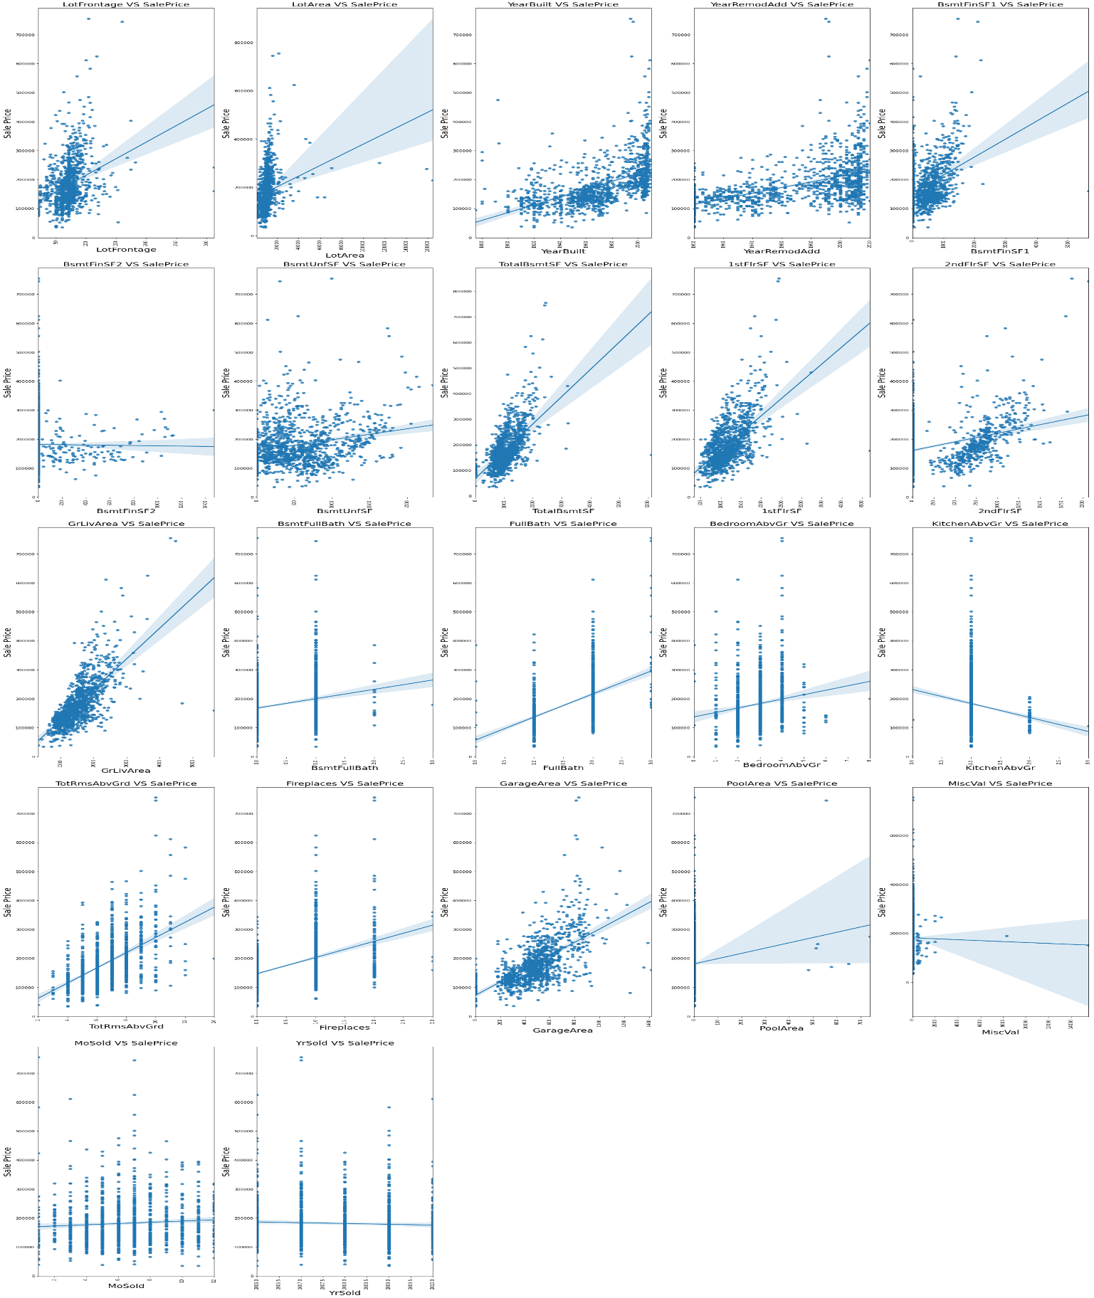
Multivariate Analysis - numerical variables with target variable
Observations:
It is visible that, as the distance from the street connected to the property increases, the sale price is also increasing.
The house sale price is increasing as the lot area of the propoerties increases.
Houses that were built recently are having higher sale price. The sale price of the house is reducing for older house properties.
Most of the houses which were recently remodeled are having slightly higher sale price.
The price of house is increasing as the square feet of type 1 finished basement of house increases.
The price of house is decreasing as the square feet of type 2 finished basement of house increases.
The price of house is increasing as the square feet of unfinished basement is increasing.
The price of house is increasing as the total square feet of the basement of house is increasing.
It shows that the price of house is increasing as the first floor and second floor square feet is increased.
The price of house is high for houses with larger above grade living area.
Houses with 1 basement full bathroom is sold more but price of house increases as there is two full bathrooms in basements
The house of price is increasing as the number of above grade full bathroom increases.
The price of house is increasing as there are more number of above grade bedrooms and total rooms above grade available in the house.
The price of house is decreasing as the number of above grade kitchens are increased in the house.
The house price is increasing as the number of fireplaces in house is increased.
The house price is higher for houses with higher garage area and/or pool area.
The price of house is reducing as $value of miscellaneous features is increased.
Most of the houses were sold in the month between May - August and in the year 2009.

Slide 13
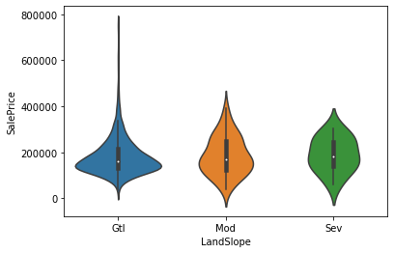
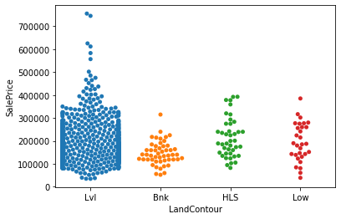
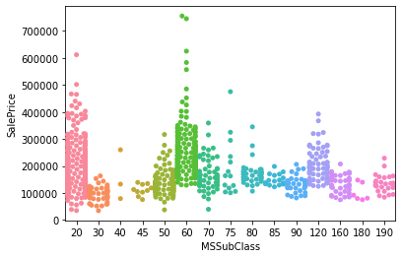
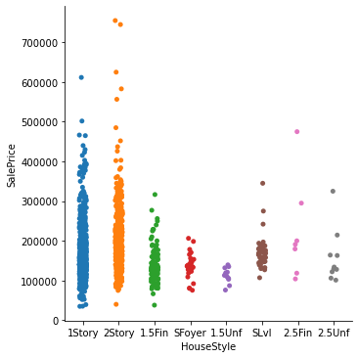
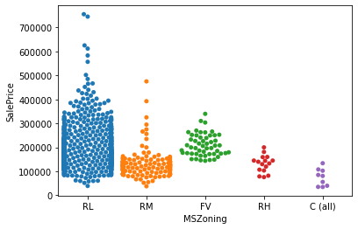
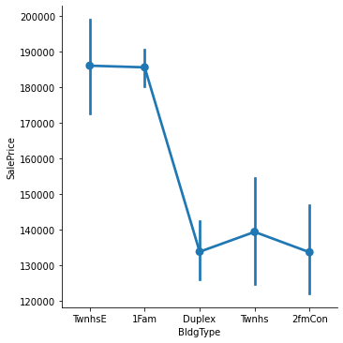
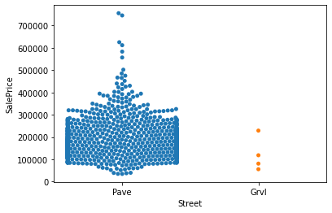
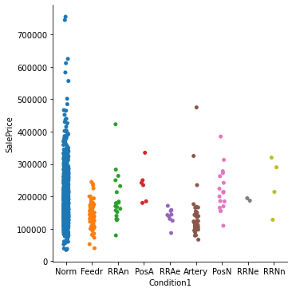
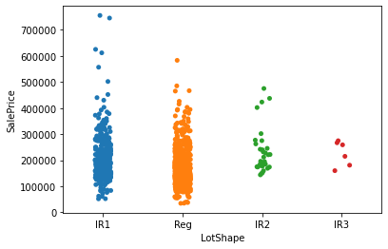
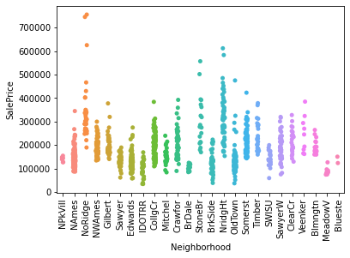
Observations:
Most of the houses having 2-STORY 1946 & NEWER as dwelling type were sold for higher price. Also 1-STORY 1946 & NEWER ALL STYLES dwelling type houses were most sold.
The house properties residing in residential and low densed area were sold for higher price and mostly sold compared to houses residing in other zoing classifications.
From the above observations, most of the houses sold are having paved type of road access to the property.
From the above observations, slightly irregular shaped property were sold for higher price.
Most of the houses sold were having flat or nearly flat property. The price for these types of houses were also comparitively high.
Most of the houses sold and which were having higher sale price were gentle slopped property.
Most of the houses in Northridge and Northridge heights are sold for higher price.
Most of the houses which are in normal conditions and which are not in proximity to arterial street, feeder street or railrods etc are sold for higher price.
Most of the houses having single family detached or town house end unit as dwelling type are sold for higher price compared to other type of dwelling houses.
Most of the houses sold were one or two story dwelling style. These were also the categories having higher sale price houses.
The house price is increasing for the properties with high rating for overall material and finish of the house.
Most of the properties sold were having 5-6 as rating for the overall condition of the house. Also houses with rating 5 were sold for higher prices compared to other rating houses.
Most of houses having gable or hip roof type were sold more compared to other roof type houses. Houses with these type of roofs were also sold for higher prices.
The price of house is higher for houses with exterior covering of wood siding and hardboard.

Slide 14
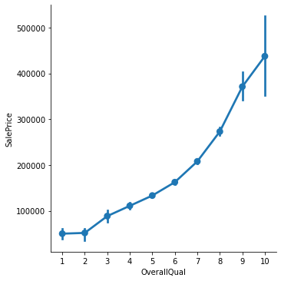
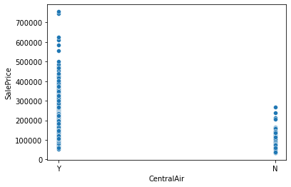
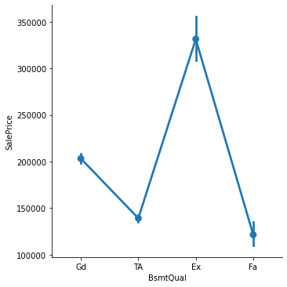
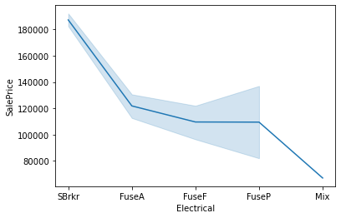
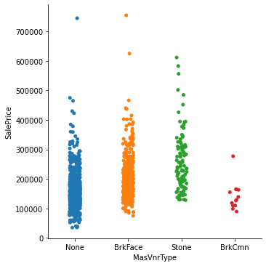
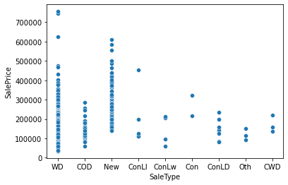






Houses with Stone as Masonry veneer type were priced higher.
Most of the houses which were rated as excellent in quality of exterial material are having high sale price.
Most of the houses with poured concrete as foundation are having higher sale volume and higher sale price.
Houses with 100+ inches basement height are having higher sale price.
The house price is higher for houses with heating type as Gas forced warm air furnace.
The sale price is higher for houses with central air conditioning.
Most of the houses sold and were having higher sale price is for houses with Standard Circuit Breakers & Romex as electrical system.
Most of the houses that are having paved driveway are having higher sale price and are mostly sold.
Most of the houses with minimum fence quality privacy are having higher sale price.
Most of the houses sold with warranty deed(Conventional) or sold after construction were having higher sale price.
Most of the houses which are normally sold are more in the dataset. But the sale price is higher for houses which were not completed wehn last assessed(associated with new homes).

Slide 15

Statistical Summary
Describe of the data
Observations:
The columns ['MSSubClass', 'LotArea', 'OverallQual', 'OverallCond', 'MasVnrArea', 'BsmtFinSF1'. 'BsmtFinSF2', 'BsmtUnfSF','TotalBsmtSF', '1stFlrSF', '2ndFlrSF', 'LowQualFinSF', 'GrLivArea', 'BsmtFullBath', 'BsmtHalfBath', 'HalfBath', 'KitchenAbvGr', 'TotRmsAbvGrd', 'WoodDeckSF', 'OpenPorchSF', 'EnclosedPorch', '3SsnPorch', 'ScreenPorch', 'PoolArea', 'MiscVal', 'MoSold', 'SalePrice'] are having higher mean value than the median value. That means skewness is present in the distribution of data of these columns.
Most of the columns are having high amount of difference between the 75% and the maximum value of the columns. That means, outliers are present in the data of these columns.

Slide 16

Encoded the Categorical Columns

Slide 17

Correlation with Target Variable
Observations:
The columns ['BsmtFinSF2', 'BsmtHalfBath', 'MiscVal', 'LowQualFinSF', 'YrSold', 'SaleType', 'LotConfig', 'MSSubClass', 'OverallCond', 'BldgType', 'BsmtFinType1', 'Heating', 'KitchenAbvGr', 'MSZoning', 'LotShape', 'BsmtExposure', 'GarageType', 'HeatingQC', 'GarageFinish', 'KitchenQual', 'ExterQual', 'BsmtQual'] are negatively correlated to the target variable 'SalePrice’.
The column 'OverallQual' is having highest positve correlation to the target variable 'SalePrice', while the column 'BsmtQual' is having highest negative correlation to the target variable 'SalePrice’.
The column 'MasVnrType' is having the least positive correlation to the target variable 'SalePrice' and the column 'BsmtFinSF2' is having the least negative correlation to the target variable 'SalePrice'.

Slide 18


Data Cleansing
Assumptions Related to the Problem Under Consideration
Removing the skewness with power transform
Numerical columns in test data with skewness beyond +/-0.7
Numerical columns in train data with skewness beyond +/-0.7

Slide 19

Distribution of Data in Numerical Columns
The numerical columns in the dataset are not having a normal distribution. That means, skewness is present in the data distribution.

Slide 20


After removing the skewness from the data using standard scaler and power transform our data looks like this:
Skewness of Train data
Skewness of Test data

Slide 21

Presence of Outliers in Data

Slide 22
Removed Outliers in the datasets
We have used two methods for outlier removal method:
Outlier removal using ZScore Technique
Outlier removal using IQR(Inter Quartile Range) Technique
By using the IQR method for outlier removal from the dataset, we have incurred a loss of data of 28% which is not acceptable as we are losing a major portion of the data. This would make our data biased. But after using the ZScore outlier removal method we are losing only 10.87% of data from the train dataset and 4.11% of data from test dataset. So, we are considering this method for removing outliers from our train and test dataset.

Slide 23

Checked and Removed Multicollinearity from the Datasets.
After calculating the VIF of the variables in the datasets, we found that the columns ['GrLivArea','TotalBsmtSF', 'YearBuilt','2ndFlrSF', 'BsmtFinSF1', 'GarageCars'] are having high variance of inflation. Thus, we had to drop these columns from the test and train dataset.

Slide 24


Final Dataset
Snapshot of Final Train Dataset
Snapshot of Final Test Dataset

Slide 25

Model/s Development and Evaluation
We created three functions for testing the model and for cross validations:
best_ran : Finding the best random state for the selected model
mod_test : Ttraining the model with the train data using the best random state.
cross_val : Finding the best cross validation mean score for each model.

Slide 26



Testing of Identified Approaches (Algorithms) and evaluation of selected models
Code Snippet for function to find best random state
Code Snippet for function to find the cross validation mean score
Code Snippet for function to test the model

Slide 27


Model DashBoard
Linear Regression
KNeighborsRegressor
Model Test Performance
KNeighborsRegressor()
At cv fold 9 the cv score is 0.7671794540397973 and the R2 score is 0.8298351804588169
Model Test Performance
LinearRegression()
At cv fold 4 the cv score is 0.841956481601463 and the R2 score is 0.8897643210612932

Slide 28






SVR
DecisionTree Regressor
RandomForest Regressor
Model Test Performance
Model Test Performance
Model Test Performance
SVR()
At cv fold 0 the cv score is 0 and the R2 score is -0.042319237303369395
DecisionTreeRegressor()
At cv fold 5 the cv score is 0.6701646628382395 and the R2 score is 0.6746053292322107
RandomForestRegressor()
At cv fold 9 the cv score is 0.843297454804246 and the R2 score is 0.8953098729820348
AdaBoostRegressor
GradientBoostingRegressor
VotingRegressor
Model Test Performance
Model Test Performance
Model Test Performance
AdaBoostRegressor()
At cv fold 2 the cv score is 0.7855981890265346 and the R2 score is 0.8233835066834014
GradientBoostingRegressor()
At cv fold 9 the cv score is 0.8707080769738818 and the R2 score is 0.9111654918760981
VotingRegressor()
At cv fold 9 the cv score is 0.7954568264992761 and the R2 score is 0.867350264164061

Slide 29





SGDRegressor
ExtraTreesRegressor
XGBRegressor
Model Test Performance
Model Test Performance
SGDRegressor()
At cv fold 8 the cv score is 0.8423369543752157 and the R2 score is 0.8882865363787905
ExtraTreesRegressor()
At cv fold 8 the cv score is 0.8399658063380535 and the R2 score is 0.9067967751346855
Model Test Performance
XGBRegressor()
At cv fold 9 the cv score is 0.8533124887375951 and the R2 score is 0.8932252246721848
LGBMRegressor
CatBoostRegressor
Model Test Performance
Model Test Performance
LGBMRegressor()
At cv fold 4 the cv score is 0.8706445896499 and the R2 score is 0.9220590015749883
CatBoostRegressor()
At cv fold 4 the cv score is 0.8760469431105571 and the R2 score is 0.9299114722099123

Slide 30

Finalized Model
After all the tests, cross validations, regularizations and hyper parameter tuning, the model is performing slighly better. The final model, CatBoost Regressor(cbr) is providing an R2 Score of 92.8%.
Snapshot of performance of the final prediction model

Slide 31

Predicting the Target Data for the Test Data
Predicted Sale Price of houses from the Test data using the built model.
The CatBoost Regression model have predicted the house prices for with the test data.
Our model was able to predict the SalePrice of the house using the test data with R2 score of 92.8%.
We have saved the new dataset with predicted saleprice as :
“House SalePrice predicted with test data.csv”

Slide 32
CONCLUSION
Key Findings and Conclusions of the Study
The successful creation of a powerful machine learning model that can predict the sale price of house using the important features was done using the CatBoost algorithm. Now this model can be used to predict the price of houses in Australia for the company Surprise Housing with the following variable information about the house.(Important Variables)
*`MSSubClass` * `BldgType` * `1stFlrSF` * `Exterior2nd` * `Exterior1st` *`OverallQual` * `TotRmsAbvGrd`
* `GarageYrBlt` * `ExterQual` * `LotArea` * `FullBath` * `YearRemodAdd` * `BsmtUnfSF` * `GarageArea`
* `CentralAir` * `BedroomAbvGr` * `BsmtQual` * `KitchenQual` * `Foundation` * `HouseStyle`
* `Fireplaces` * `OverallCond` * `MasVnrArea` * `HalfBath` *`BsmtFinType1` *`BsmtFullBath` * `LotFrontage`
* `GarageFinish`* `GarageQual` * `MasVnrType` * `BsmtExposure` * `GarageType` * `LandSlope` * `Heating`
* `HeatingQC` * `GarageCond` * `MSZoning` * `PavedDrive` * `WoodDeckSF` * `SaleCondition` * `FireplaceQu`
* `LandContour` * `LotShape` * `Electrical` * `RoofStyle` * `Street` * `SaleType` * `Functional`
* `Neighborhood` * `OpenPorchSF` * `Condition2` * `ExterCond` *`MoSold` * `Fence` * `LotConfig` *`BsmtFinType2`
* `Condition1` *`BsmtCond` * `RoofMatl` * `YrSold`

Slide 33
Impact of Variables on Target Variable(Correlation)
The columns ['1stFlrSF', 'Exterior2nd', 'Exterior1st', 'OverallQual', 'TotRmsAbvGrd', 'GarageYrBlt', 'LotArea', 'FullBath', 'YearRemodAdd', 'BsmtUnfSF', 'GarageArea', 'CentralAir', 'BedroomAbvGr', 'Foundation', 'HouseStyle', 'Fireplaces', 'MasVnrArea', 'HalfBath', 'BsmtFullBath', 'LotFrontage', 'GarageQual', 'MasVnrType', 'LandSlope', 'GarageCond', 'PavedDrive', 'WoodDeckSF', 'SaleCondition', 'FireplaceQu', 'LandContour', 'Electrical', 'RoofStyle', 'Street', 'Functional', 'Neighborhood', 'OpenPorchSF', 'Condition2', 'ExterCond', 'MoSold', 'Fence', 'BsmtFinType2', 'Condition1', 'BsmtCond', 'RoofMatl'] are positively correlated to the target variable 'SalePrice'. That means increase in the contribution of these variables for a house will increase the sale price of the house property.
The columns ['YrSold', 'SaleType', 'LotConfig', 'MSSubClass', 'OverallCond', 'BldgType', 'BsmtFinType1', 'Heating', 'MSZoning', 'LotShape', 'BsmtExposure', 'GarageType', 'HeatingQC', 'GarageFinish', 'KitchenQual', 'ExterQual', 'BsmtQual'] are negatively correlated to the Target Variable 'SalePrice'. That increase in the contribution of these variables for a house will reduce its sale price.

Slide 34


To check whether the model is performing well with predictions, we have made predictions on train data which already have the exact sale price. So, we can check the variance of predicted and actual price of the house and evaluate the performance of the model in predictions.
Plotting the Actual and predicted data
Sample Snapshot of predicted and actual sale price
Our model is performing well with predictions and provided almost accurate results.

Slide 35
Scope
While real estate and housing have been dominating the market since a long time, it is always volatile and subject to market and economic conditions. But with the integration of machine learning and data science, we can analyze the vast input data that influence the valuation of house properties and draw inferences from this big data.
Many of the real estate giants and housing companies already started implementing machine learning and early adoption of data science in this sector to maintain their dominancy. This unleashes a vast scope for data science and machine learning in this sector because of the instant impact and huge savings on time and effort in the research.
Implementation and application of machine learning algorithms in this sector is not limited to providing accurate predictions through various input features, it is further giving option for recalibration of the model as the market is always fluctuating and the features influencing the house pricing and valuation can always change. So, with machine learning and data science our model is forward looking and can cope with changes in features with an option to addition of new features and removal of existing features from the predicting framework.

Slide 36
Thank You

